Slide 1
Chapter 6
Applications
Grigoris Antoniou
Frank van Harmelen
Chapter 6
A Semantic Web Primer

Slide 2
Lecture Outline
Horizontal Information Products at Elsevier
Openacademia: Distributed Publication Management
Bibster: Data Exchange in a P2P System
Data Integration at Audi
Skill Finding at Swiss Life
Think Tank Portal at EnerSearch
E-Learning
Web Services
Other Scenarios
Chapter 6
A Semantic Web Primer

Slide 3
Elsevier – The Setting
Elsevier is a leading scientific publisher.
Its products are organized mainly along traditional lines:
  Subscriptions to journals
Online availability of these journals has until now not really changed the organisation of the productline
Customers of Elsevier can take subscriptions to online content
Chapter 6
A Semantic Web Primer

Slide 4
Elsevier – The Problem
Traditional journals are vertical products
Division into separate sciences covered by distinct journals is no longer satisfactory
Customers of Elsevier are interested in covering certain topic areas that spread across the traditional disciplines/journals
The demand is rather for horizontal products
Chapter 6
A Semantic Web Primer

Slide 5
Elsevier – The Problem (2)
Currently, it is difficult for large publishers to offer such horizontal products
  Barriers of physical and syntactic heterogeneity can be solved (with XML)
  The semantic problem remains unsolved
We need a way to search the journals on a coherent set of concepts against which all of these journals are indexed
Chapter 6
A Semantic Web Primer

Slide 6
Elsevier – The Contribution of Semantic Web Technology
Ontologies and thesauri (very lightweight ontologies) have proved to be a key technology for effective information access
  They help to overcome some of the problems of free-text search
  They relate and group relevant terms in a specific domain
  They provide a controlled vocabulary for indexing information
Chapter 6
A Semantic Web Primer

Slide 7
Elsevier – The Contribution of Semantic Web Technology (2)
A number of thesauri have been developed in different domains of expertise
  Medical information: MeSH and Elsevier’s life science thesaurus EMTREE
RDF is used as an interoperability format between heterogeneous data sources
EMTREE is itself represented in RDF
Chapter 6
A Semantic Web Primer

Slide 8
Elsevier – The Contribution of Semantic Web Technology (3)
Each of the separate data sources is mapped onto this unifying ontology
  The ontology is then used as the single point of entry for all of these data sources
Chapter 6
A Semantic Web Primer

Slide 9
Elsevier – The Results
Elsevier has sponsored the DOPE project (Drug Ontology Project for Elsevier)
  The EMTREE thesaurus was used to index millions of medical abstracts and full text articles
In the interface used, the EMTREE ontology was used to:
  disambiguate the original free-text user query
  categorize the results
  produce a visual clustering of the search results
  narrow or widen the search query in a meaningful way
Chapter 6
A Semantic Web Primer

Slide 10
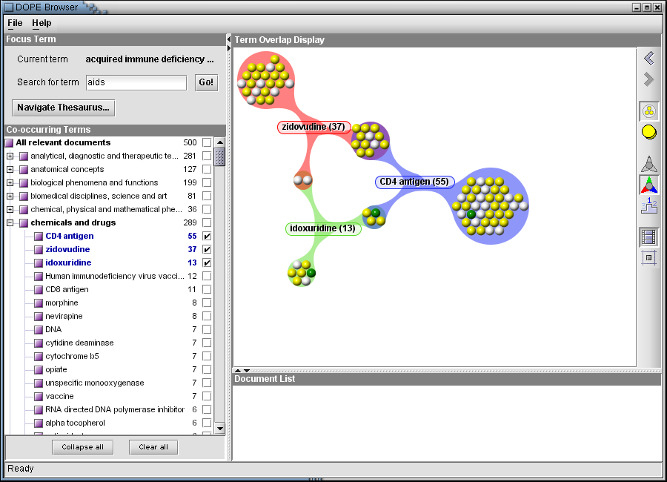
DOPE Search and Browse Interface
Chapter 6
A Semantic Web Primer

Slide 11
Lecture Outline
Horizontal Information Products at Elsevier
Openacademia: Distributed Publication Management
Bibster: Data Exchange in a P2P System
Data Integration at Audi
Skill Finding at Swiss Life
Think Tank Portal at EnerSearch
E-Learning
Web Services
Other Scenarios
Chapter 6
A Semantic Web Primer

Slide 12
Openacademia – The Setting
Information about scientific publications is often maintained by individual researchers
Reference management software such as EndNote and BibTeX helps researchers to maintain personal collections of bibliographic references
Most researchers have to maintain a Web page about publications for interested peers from other institutes
Often personal reference management and the maintenance of Web pages are isolated efforts
The author of a new publication adds the reference to his own collection and updates his Web page
Chapter 6
A Semantic Web Primer

Slide 13
Openacademia – The Problem
Maintaining personal references and Web pages about publications should not require redundant efforts
One can achieve this by directly using individual bibliographical records generate personal Web pages and joined publication lists for Web pages at the group or institutional level
Chapter 6
A Semantic Web Primer

Slide 14
Openacademia – The Problem (2)
Several problems need to be solved:
  Information from different files and possibly in different formats has to be collected and integrated
  Duplicate information should be detected and merged
  It should be possible to query for specific selections of the bibliographic entries and represent them in customized layouts
Chapter 6
A Semantic Web Primer

Slide 15
Openacademia – The Contribution of Semantic Web Technology
All tasks in openacademia are performed on RDF representations of the data, and only standard ontologies are used to describe the meaning of the data
Moreover, W3C standards are used for the transformation and presentation of the information
Chapter 6
A Semantic Web Primer

Slide 16
Functionality
The most immediate service of openacademia is to enable generating an HTML representation of a personal collection of publications and publishing it on the Web
This requires filling out a single form on the Web site, which generates the code (one line of javaScript!) that needs to be inserted into the body of the home page
Chapter 6
A Semantic Web Primer

Slide 17
Functionality (2)
The code inserts the publication list in the page dynamically, and thus there is no need to update the page separately if the underlying collection changes
The appearance of the publication list can be customized by a variety of style sheets
One can also generate an RSS feed from the collection
Chapter 6
A Semantic Web Primer

Slide 18
Functionality (3)
The RSS feeds of openacademia are RDF-based and can also be consumed by any RDF-aware software
Research groups can install their own openacademia server
Groups can have their RSS feeds as well
Chapter 6
A Semantic Web Primer

Slide 19
Functionality (4)
There is also an AJAX-based interface for browsing and searching the publication collection which builds queries and displays the results
This interface offers a number of visualizations (e.g. see publications along a time line that can be scrolled using a mouse)
Chapter 6
A Semantic Web Primer

Slide 20
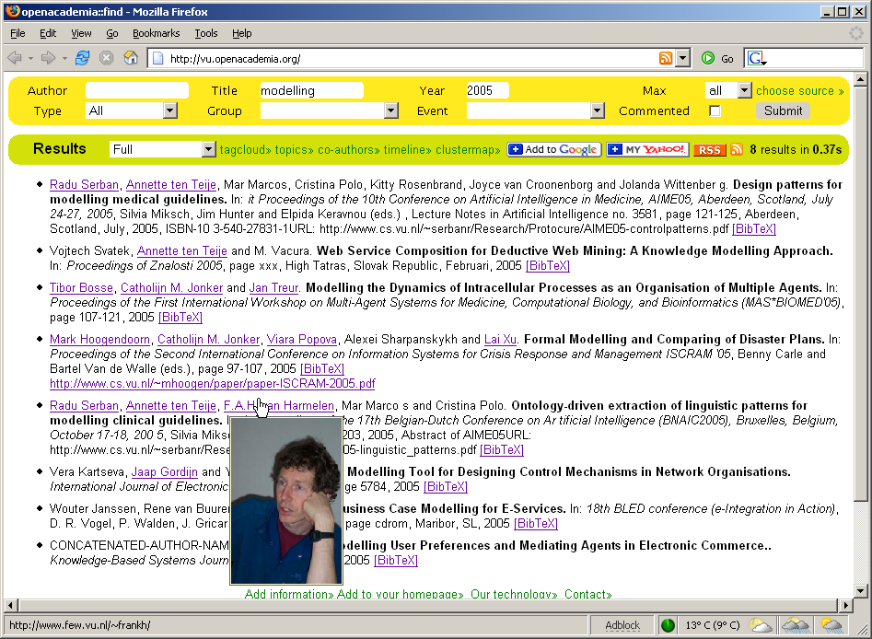
AJAX-based Query interface
Chapter 6
A Semantic Web Primer

Slide 21
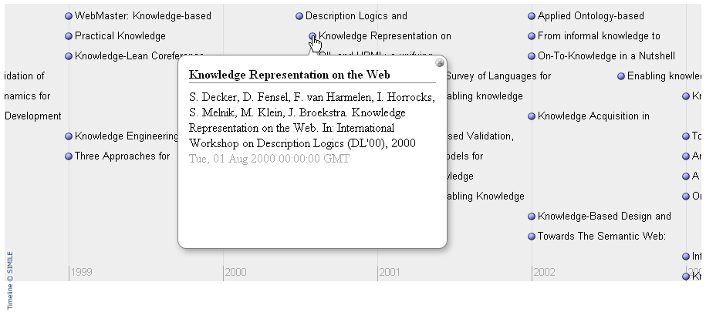
The Timeline Widget
Chapter 6
A Semantic Web Primer

Slide 22
Information Sources
Openacademia uses the RDF-based FOAF (Friend of a Friend) format as a schema for information about persons and groups
To have their information included in openacademia researchers need to have a FOAF profile that contains at least their name and a link to a file with their publications
Anyone can generate a FOAF profile
Chapter 6
A Semantic Web Primer

Slide 23
Information Sources (2)
To be able to make selections on groups, information about group membership is required
This can also be specified in a FOAF file
Alternatively, it can be generated from a database
Chapter 6
A Semantic Web Primer

Slide 24
Information Sources (3)
For data about publications, openacademia uses the Semantic Web Research Community (SWRC) ontology as a basic schema
It also accepts BibTeX
The BibTeX files are translated to RDF using the BibTex-2-RDF service, which creates instance data for the SWRC ontology
Chapter 6
A Semantic Web Primer

Slide 25
Information Sources (4)
A simple extension of the SWRC ontology was necessary to preserve the sequence of authors of publications
To this end the properties swrc-ext:authorList and swrc-ext:editorList are defined, which have rdf:Seq as range, comprising an ordered list of authors
The crawler in openacademia collects the FOAF profiles and publication files
All data are subsequently stored in an RDF database
Chapter 6
A Semantic Web Primer

Slide 26
Integration
The system has to deal with the increasing semantic heterogeneity of information sources
Heterogeneity affects both the schema and the instance levels
The schemas used are stable, lightweight Web ontologies, so their mapping causes no problem
Chapter 6
A Semantic Web Primer

Slide 27
Integration (2)
Openacademia uses a bridging ontology that specifies the relations between important classes in both ontologies (e.g. swrc:Author should be considered a sub-class of foaf:Person)
Heterogeneity on the instance level arises from using different identifiers in the sources for denoting the same real-world objects
This certainly affects FOAF data collected from the Web, as well as publication information
Chapter 6
A Semantic Web Primer

Slide 28
Integration (3)
A so-called smusher is used to match foaf:Person instances based on name and inverse functional properties
  e.g if two persons have the same value for their e-mail addresses (or checksums), we can conclude that the two persons are the same
Publications are matched on a combination of properties
The instance matches that are found are stored in the RDF store using the owl:sameAs property
Chapter 6
A Semantic Web Primer

Slide 29
Integration (4)
These rules express the reflexive, symmetric and transitive nature of the property as well as the intended meaning, namely, the equality of property values
Chapter 6
A Semantic Web Primer

Slide 30
Presentation
After all information has been merged, the triple store can be queried to produce publications lists according to a variety of criteria, including personal, group, or publication facets
The online interface helps users to build such queries against the publication repository
Chapter 6
A Semantic Web Primer

Slide 31
Presentation (2)
The following query, formulated in the SeRQL query language, returns all publications authored by the members of the AI department (uniquely identified by its home page) in 2004
Note that the successful resolution of this query relies on the schema and instance matching described in the previous section
Researchers can change their personal profiles and update their publication lists without the need to consult or notify anyone
Chapter 6
A Semantic Web Primer

Slide 32
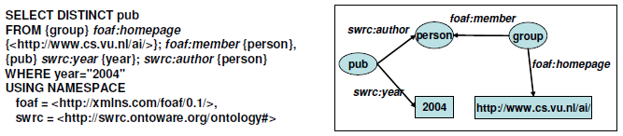
Presentation (2)
Chapter 6
A Semantic Web Primer

Slide 33
Lecture Outline
Horizontal Information Products at Elsevier
Openacademia: Distributed Publication Management
Bibster: Data Exchange in a P2P System
Data Integration at Audi
Skill Finding at Swiss Life
Think Tank Portal at EnerSearch
E-Learning
Web Services
Other Scenarios
Chapter 6
A Semantic Web Primer

Slide 34
Bibster – The Setting
The openacademia system uses a semicentralized solution for collecting, storing and sharing bibliographic information
Centralized, because it harvests data into a single centralized repository
Semi-centralized because it harvests the bibliographic data from the files of individual researchers
In this section we describe a fully distributed approach to the same problem
Chapter 6
A Semantic Web Primer

Slide 35
Bibster – The Problem
Any centralized solution relies on the performance of the centralized node in the system
  How often does the crawler refresh the collected data-items, how reliable is the central server, will the central server become a performance bottleneck?
Many researchers share their data only as long as they are able to maintain local control over the information, instead of handing it over to a central server outside their control
Chapter 6
A Semantic Web Primer

Slide 36
Bibster – The Problem (2)
With Bibster, researchers may want to:
  Query a singe specific peer, a specific set of peers, or the entire network of peers
  Search for bibliographic entries using simple keyword searches, but also more advanced, semantic searches
  Integrate results of a query into a local repository for future use. Such data may in turn be used to answer queries by other peers. They may also be interested in in updating items that are already locally stored
Chapter 6
A Semantic Web Primer

Slide 37
Bibster – The Contribution of the Semantic Web Technology
Ontologies are used by Bibster for a number of purposes:
  importing data,
  formulating queries,
  routing queries,
  and processing answers
Chapter 6
A Semantic Web Primer

Slide 38
Importing Data
The system enables users to import their own bibliographic metadata into a local repository
Bibliographic entries made available to Bibster by users are automatically aligned to two ontologies
  The first ontology (SWRC) describes different generic aspects of bibliographic metadata
  The second ontology (ACM Topic Ontology) describes specific categories of literature for the computer science domain
Chapter 6
A Semantic Web Primer

Slide 39
Formulating queries
Queries are formulated in terms of the two ontologies
Queries may concern fields like author or publication type, or specific computer science terms
Chapter 6
A Semantic Web Primer

Slide 40
Routing queries
Queries are routed through the network depending on the expertise models of the peers describing which concepts from the ACM ontology a peer can answer queries on
A matching function determines how closely the semantic content of a query matches the expertise model of a peer
Routing is then done on the basis of this semantic ranking
Chapter 6
A Semantic Web Primer

Slide 41
Processing Answers
Because of the distributed nature and potentially large size of the p2p network, an answer set might be very large and contain many duplicate answers
Because of the semistructured nature of bibliographic metadata, such duplicates are often not exactly identical copies
Ontologies help to measure the semantic similarity between the different answers and remove apparent duplicates as identified by the similarity function
Chapter 6
A Semantic Web Primer

Slide 42
Bibster – The Results
The following screenshot indicates how the use cases are realized in Bibster
  The scope widget allows for defining the targeted peers
  The Search and Search Details widgets allow for keyword and semantic search
  The Results Table and BibTeXView widgets allow for browsing and reusing query results
  The query results are visualized in a list grouped by duplicates
  They may be integrated into the local repository, or exported into formats, such as BibTeX and HTML
Chapter 6
A Semantic Web Primer

Slide 43
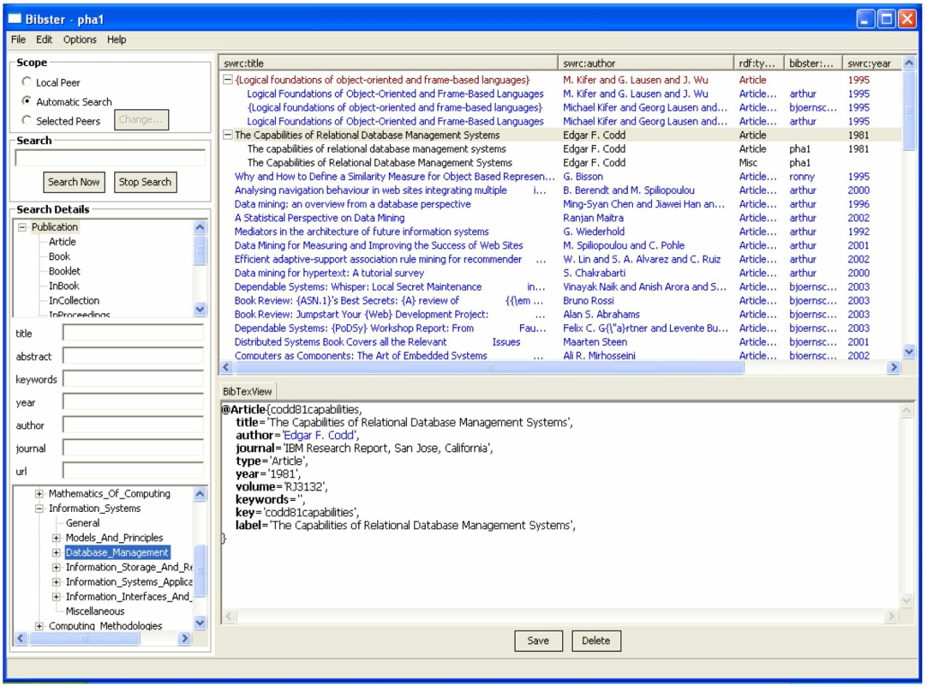
Bibster P2P Bibliography finder
Chapter 6
A Semantic Web Primer

Slide 44
Lecture Outline
Horizontal Information Products at Elsevier
Openacademia: Distributed Publication Management
Bibster: Data Exchange in a P2P System
Data Integration at Audi
Skill Finding at Swiss Life
Think Tank Portal at EnerSearch
E-Learning
Web Services
Other Scenarios
Chapter 6
A Semantic Web Primer

Slide 45
Audi – The Problem
Data integration is also a huge problem internal to companies
  It is the highest cost factor in the information technology budget of large companies
  Audi operates thousands of databases
Traditional middleware improves and simplifies the integration process
  But it misses the sharing of information based on the semantics of the data
Chapter 6
A Semantic Web Primer

Slide 46
Audi – The Contribution of Semantic Web Technology
Ontologies can rationalize disparate data sources into one body of information
Without disturbing existing applications, by:
  creating ontologies for data and content sources
  adding generic domain information
The ontology is mapped to the data sources giving applications direct access to the data through the ontology
Chapter 6
A Semantic Web Primer

Slide 47
Audi – Camera Example
<SLR rdf:ID="Olympus-OM-10">
<viewFinder>twin mirror</viewFinder>
<optics>
<Lens>
<focal-length>75-300mm zoom</focal-length>
<f-stop>4.0-4.5</f-stop>
</Lens>
</optics>
<shutter-speed>1/2000 sec. to 10 sec.</shutter-speed>
</SLR>
Chapter 6
A Semantic Web Primer

Slide 48
Audi – Camera Example (2)
<Camera rdf:ID="Olympus-OM-10">
<viewFinder>twin mirror</viewFinder>
<optics>
<Lens>
<size>300mm zoom</size>
<aperture>4.5</aperture>
</Lens>
</optics>
<shutter-speed>1/2000 sec. to 10 sec.</shutter-speed>
</Camera>
Chapter 6
A Semantic Web Primer

Slide 49
Audi – Camera Example (3)
Human readers can see that these two different formats talk about the same object
  We know that SLR is a kind of camera, and that fstop is a synonym for aperture
Ad hoc integration of these data sources by translator is possible
Would only solve this specific integration problem
We would have to do the same again when we encountered the next data format for cameras
Chapter 6
A Semantic Web Primer

Slide 50
Audi – Camera Ontology in OWL
<owl:Class rdf:ID="SLR">
<rdfs:subClassOf rdf:resource="#Camera"/>
</owl:Class>
<owl:DatatypeProperty rdf:ID="f-stop">
<rdfs:domain rdf:resource="#Lens"/>
</owl:DatatypeProperty>
<owl:DatatypeProperty rdf:ID="aperture">
<owl:equivalentProperty rdf:resource="#f-stop"/>
</owl:DatatypeProperty>
<owl:DatatypeProperty rdf:ID="focal-length">
<rdfs:domain rdf:resource="#Lens"/>
</owl:DatatypeProperty>
<owl:DatatypeProperty rdf:ID="size">
<owl:equivalentProperty rdf:resource="#focal-length"/>
</owl:DatatypeProperty>
Chapter 6
A Semantic Web Primer

Slide 51
Audi – Using the Ontology
Suppose that an application A
  is using the second encoding
  is receiving data from an application B using the first encoding
Suppose it encounters SLR
  Ontology returns “SLR is a type of Camera”
  A relation between something it doesn’t know (SLR) to something it does know (Camera)
Chapter 6
A Semantic Web Primer

Slide 52
Audi – Using the Ontology (2)
Suppose A encounters f-stop
  The Ontology returns: “f-stop is synonymous with aperture”
Bridges the terminology gap between something A doesn’t know to something A does know
Syntactic divergence is no longer a hindrance
Chapter 6
A Semantic Web Primer

Slide 53
Lecture Outline
Horizontal Information Products at Elsevier
Openacademia: Distributed Publication Management
Bibster: Data Exchange in a P2P System
Data Integration at Audi
Skill Finding at Swiss Life
Think Tank Portal at EnerSearch
E-Learning
Web Services
Other Scenarios
Chapter 6
A Semantic Web Primer

Slide 54
Swiss Life – The Setting
Swiss Life is one of Europe’s leading life insurers
  11,000 employees, $14 billion of written premiums
  Active in about 50 different countries
The most important resources of any company for solving knowledge intensive tasks are:
  The tacit knowledge, personal competencies, and skills of its employees
Chapter 6
A Semantic Web Primer

Slide 55
Swiss Life – The Problem
One of the major building blocks of enterprise knowledge management is:
  An electronically accessible repository of people’s capabilities, experiences, and key knowledge areas
A skills repository can be used to:
  enable a search for people with specific skills
  expose skill gaps and competency levels
  direct training as part of career planning
  document the company’s intellectual capital
Chapter 6
A Semantic Web Primer

Slide 56
Swiss Life – The Problem (2)
Problems
  How to list the large number of different skills?
  How to organise them so that they can be retrieved across geographical and cultural boundaries?
  How to ensure that the repository is updated frequently?
Chapter 6
A Semantic Web Primer

Slide 57
Swiss Life – The Contribution of Semantic Web Technology
Hand-built ontology to cover skills in three organizational units
  Information Technology, Private Insurance and Human Resources
Individual employees within Swiss Life were asked to create “home pages” based on form filling driven by the skills-ontology
The corresponding collection could be queried using a form-based interface that generated RQL queries
Chapter 6
A Semantic Web Primer

Slide 58
Swiss Life – Skills Ontology
<owl:Class rdf:ID="Skills">
<rdfs:subClassOf>
<owl:Restriction>
<owl:onProperty rdf:resource="#HasSkillsLevel"/>
<owl:cardinality rdf:datatype="&xsd;nonNegativeInteger">
1</owl:cardinality>
</owl:Restriction>
</rdfs:subClassOf>
</owl:Class>
<owl:ObjectProperty rdf:ID="HasSkills">
<rdfs:domain rdf:resource="#Employee"/>
<rdfs:range rdf:resource="#Skills"/>
</owl:ObjectProperty>
Chapter 6
A Semantic Web Primer

Slide 59
Swiss Life – Skills Ontology (2)
<owl:ObjectProperty rdf:ID="WorksInProject">
<rdfs:domain rdf:resource="#Employee"/>
<rdfs:range rdf:resource="#Project"/>
<owl:inverseOf rdf:resource="#ProjectMembers"/>
</owl:ObjectProperty>
<owl:Class rdf:ID="Publishing">
<rdfs:subClassOf rdf:resource="#Skills"/>
</owl:Class>
<owl:Class rdf:ID="DocumentProcessing">
<rdfs:subClassOf rdf:resource="#Skills"/>
</owl:Class>
Chapter 6
A Semantic Web Primer

Slide 60
Swiss Life – Skills Ontology (3)
<owl:ObjectProperty rdf:ID="ManagementLevel">
<rdfs:domain rdf:resource="#Employee"/>
<rdfs:range>
<owl:oneOf rdf:parseType="Collection">
<owl:Thing rdf:about="#member"/>
<owl:Thing rdf:about="#HeadOfGroup"/>
<owl:Thing rdf:about="#HeadOfDept"/>
<owl:Thing rdf:about="#CEO"/>
</owl:oneOf>
</rdfs:range>
</owl:ObjectProperty>
Chapter 6
A Semantic Web Primer

Slide 61
Lecture Outline
Horizontal Information Products at Elsevier
Openacademia: Distributed Publication Management
Bibster: Data Exchange in a P2P System
Data Integration at Audi
Skill Finding at Swiss Life
Think Tank Portal at EnerSearch
E-Learning
Web Services
Other Scenarios
Chapter 6
A Semantic Web Primer

Slide 62
EnerSearch – The Setting
An industrial research consortium focused on information technology in energy
EnerSearch has a structure very different from a traditional research company
  Research projects are carried out by a varied and changing group of researchers spread over different countries
  Many of them are not employees of EnerSearch
Chapter 6
A Semantic Web Primer

Slide 63
EnerSearch – The Setting (2)
EnerSearch is organized as a virtual organization
Owned by a number of firms in the industry sector that have an express interest in the research being carried out
Because of this wide geographical spread, EnerSearch also has the character of a virtual organisation from a knowledge distribution point of view
Chapter 6
A Semantic Web Primer

Slide 64
EnerSearch – The Problem
Dissemination of knowledge key function
The information structure of the web site leaves much to be desired
It does not satisfy the needs of info seekers, e.g.
  Does load management lead to cost-saving?
  If so, what are the required upfront investments?
  Can powerline communication be technically competitive to ADSL or cable modems?
Chapter 6
A Semantic Web Primer

Slide 65
EnerSearch – The Contribution of Semantic Web Technology
It is possible to form a clear picture of what kind of topics and questions would be relevant for these target groups
It is possible to define a domain ontology that is sufficiently stable and of good quality
  This lightweight ontology consisted only of a taxonomical hierarchy
  Needed only RDF Schema expressivity
Chapter 6
A Semantic Web Primer

Slide 66
EnerSearch – Lunchtime Ontology
...
IT
Hardware
Software
Applications
Communication
Powerline
Agent
Electronic Commerce
Agents
Multi-agent systems
Intelligent agents
Market/auction
Resource allocation
Algorithms
Chapter 6
A Semantic Web Primer

Slide 67
EnerSearch – Use of Ontology
Used in a number of different ways to drive navigation tools on the EnerSearch web site
  Semantic map of the EnerSearch web site
  Semantic distance between EnerSearch authors in terms of their fields of research and publication
Chapter 6
A Semantic Web Primer

Slide 68
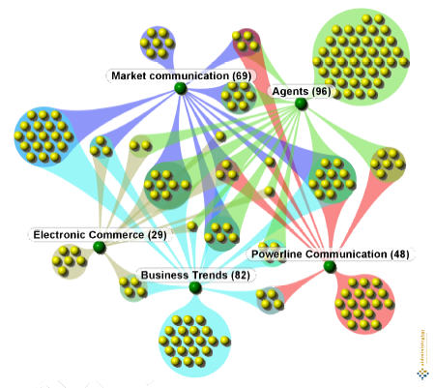
Semantic Map of Part of the EnerSearch Web Site
Chapter 6
A Semantic Web Primer

Slide 69
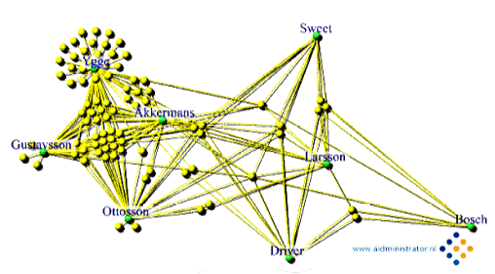
Semantic Distance between EnerSearch Authors
Chapter 6
A Semantic Web Primer

Slide 70
EnerSearch – QuizRDF
QuizRDF aims to combine
  an entirely ontology based display
  a traditional keyword based search without any semantic grounding
The user can type in general keywords
It also displays those concepts in the hierarchy which describe these papers
All these disclosure mechanisms (textual and graphic, searching or browsing) based on a single underlying lightweight ontology
Chapter 6
A Semantic Web Primer

Slide 71
Lecture Outline
Horizontal Information Products at Elsevier
Openacademia: Distributed Publication Management
Bibster: Data Exchange in a P2P System
Data Integration at Audi
Skill Finding at Swiss Life
Think Tank Portal at EnerSearch
E-Learning
Web Services
Other Scenarios
Chapter 6
A Semantic Web Primer

Slide 72
E-Learning – The Setting
Traditionally learning has been characterized by the following properties:
  Educator-driven
  Linear access
  Time- and locality-dependent
  Learning has not been personalized but rather aimed at mass participation
Chapter 6
A Semantic Web Primer

Slide 73
E-Learning – The Setting (2)
The changes are already visible in higher education
  Virtual universities
  Flexibility and new educational means
  Students can increasingly make choices about pace of learning, content, evaluation methods
Chapter 6
A Semantic Web Primer

Slide 74
E-Learning – The Setting (3)
Even greater promise: life long learning activities
  Improvement of the skills of its employees ic critical to companies
  Organizations require learning processes that are just-in-time, tailored to their specific needs
  These requirements are not compatible with traditional learning, but e-learning shows great promise for addressing these concerns
Chapter 6
A Semantic Web Primer

Slide 75
E-Learning – The Problem
E-learning is not driven by the instructor
Learners can:
  Access material in an order that is not predefined
  Compose individual courses by selecting educational material
Learning material must be equipped with additional information (metadata) to support effective indexing and retrieval
Chapter 6
A Semantic Web Primer

Slide 76
E-Learning – The Problem (2)
Standards (IEEE LOM) have emerged
  E.g. educational and pedagogical properties, access rights and conditions of use, and relations to other educational resources
Standards suffer from lack of semantics
  This is common to all solutions based solely on metadata (XML-like approaches)
  Combining of materials by different authors may be difficult
  Retrieval may not be optimally supported
  Retrieval and organization of learning resources must be made manually
  Could be done by a personalized automated agent instead!
Chapter 6
A Semantic Web Primer

Slide 77
E-Learning – The Contribution of Semantic Web Technology
Establish a promising approach for satisfying the e-learning requirements
  E.g. ontology and machine-processable metadata
Learner-centric
  Learning materials, possibly by different authors, can be linked to commonly agreed ontologies
  Personalized courses can be designed through semantic querying
  Learning materials can be retrieved in the context of actual problems, as decided by the learner
Chapter 6
A Semantic Web Primer

Slide 78
E-Learning – The Contribution of Semantic Web Technology (2)
Flexible access
  Knowledge can be accessed in any order the learner wishes
  Appropriate semantic annotation will still define prerequisites
  Nonlinear access will be supported
Integration
  A uniform platform for the business processes of organizations
  Learning activities can be integrated in these processes
Chapter 6
A Semantic Web Primer

Slide 79
Ontologies for E-Learning
Some mechanism for establishing a shared understanding is needed: ontologies
In e-learning we distinguish between three types of knowledge (ontologies):
  Content
  Pedagogy
  Structure
Chapter 6
A Semantic Web Primer

Slide 80
Content Ontologies
Basic concepts of the domain in which learning takes place
Include the relations between concepts, and basic properties
  E.g., the study of Classical Athens is part of the history of Ancient Greece, which in turn is part of Ancient History
  The ontology should include the relation “is part of” and the fact that it is transitive (e.g., expressed in OWL)
COs use relations to capture synonyms, abbreviations, etc.
Chapter 6
A Semantic Web Primer

Slide 81
Pedagogy Ontologies
Pedagogical issues can be addressed in a pedagogy ontology (PO)
E.g. material can be classified as lecture, tutorial, example, walk-through, exercise, solution, etc.
Chapter 6
A Semantic Web Primer

Slide 82
Structure Ontologies
Define the logical structure of the learning materials
Typical knowledge of this kind includes hierarchical and navigational relations like previous, next, hasPart, isPartOf, requires, and isBasedOn
Relationships between these relations can also be defined
  E.g., hasPart and isPartOf are inverse relations
Inferences drawn from learning ontologies cannot be very deep
Chapter 6
A Semantic Web Primer

Slide 83
Lecture Outline
Horizontal Information Products at Elsevier
Openacademia: Distributed Publication Management
Bibster: Data Exchange in a P2P System
Data Integration at Audi
Skill Finding at Swiss Life
Think Tank Portal at EnerSearch
E-Learning
Web Services
Other Scenarios
Chapter 6
A Semantic Web Primer

Slide 84
Web Services
Web sites that do not merely provide static information, but involve interaction with users and often allow users to effect some action
Simple Web services involve a single Web-accessible program, sensor, device
Complex Web services are composed of simpler services
  Often they require ongoing interaction with the user
  The user can make choices or provide information conditionally
Chapter 6
A Semantic Web Primer

Slide 85
A Complex Web Service
User interaction with an online music store involves
  searching for CDs and titles by various criteria
  reading reviews and listening to samples
  adding CDs to a shopping cart
  providing credit card details, shipping details, and delivery address
Chapter 6
A Semantic Web Primer

Slide 86
The Problem
SOAP, WSDL, UDDI and BPEL4WS are the standard technology combination to build a Web service application
They fail to achieve the goals of automation and interoperability because the require humans in the loop
WSDL specifies the functionality of a service only at a syntactic level but does not describe the meaning of the Web service functionality
Chapter 6
A Semantic Web Primer

Slide 87
The Contribution of Semantic Web Technology
The Semantic Web community addressed the limitations of current Web service technology by augmenting the service descriptions with a semantic layer in order to achieve
  Automatic discovery, composition, monitoring, and execution
The automation of these tasks is highly desirable
Chapter 6
A Semantic Web Primer

Slide 88
The Contribution of Semantic Web Technology Example Scenario
The example task is specializing the more generic task of finding the closest medical provides
A strategy for performing this task is
  Retrieve the details of all medical providers
  Select the closest by computing the distance between the location of the provider and a reference location
Chapter 6
A Semantic Web Primer

Slide 89
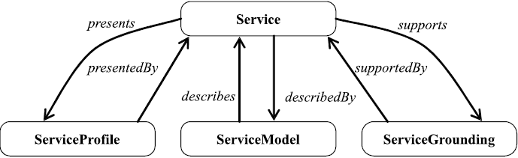
OWL-S service ontology
Chapter 6
A Semantic Web Primer

Slide 90
The Contribution of Semantic Web Technology Example Scenario (2)
Semantic Web service technology aims to automate performing such tasks based on the semantic description of Web services
A common characteristic of all emerging frameworks for semantic Web service descriptions is the they combine two kinds of ontologies to obtain a service description
  A generic Web service ontology
  A domain ontology
Chapter 6
A Semantic Web Primer

Slide 91
Generic Web Service Ontologies
OWL-S
OWL-S ontology is conceptually divided into four subontologies for specifying
  What the service does (Profile)
  How the service works (Process)
  How the service is implemented (Grounding)
  A fourth ontology (Service) contains the Service concept, which links together the ServiceProfile, ServiceModel and ServiceGrounding
Chapter 6
A Semantic Web Primer

Slide 92
The Profile Ontology
Profile specifies :
  The functionality offered by the service
  The semantic type of the inputs and outputs
  The details of the service provider
  Several service parameters, such as quality rating or geographic radius
Profile is a subclass of ServiceProfile
Chapter 6
A Semantic Web Primer

Slide 93
The Profile Ontology (2)
For each Profile instance we associate
  the process it describes
  its functional characteristics together with their type
Chapter 6
A Semantic Web Primer

Slide 94
The Profile Ontology example
Service MedicareSupplier:
  *Profile : FindMedicareSupplierByZip (hasProc P1)
  (I (ZipCode), O (SupplierDetails))
  *Profile : FindMedicareSupplierByCity (hasProc P2)
  (I (City), O (SupplierDetails))
  *Profile : FindMedicareSupplierBySupply (hasProc P3)
  (I (SupplyType), O (SupplierDetails))
  *ProcessModel : …
  *WSDLGrounding : …
Chapter 6
A Semantic Web Primer

Slide 95
The Process Ontology
Many complex services consist of smaller executed in a certain order
For example, buying a book at Amazon.com involves using a browsing service and a paying service
OWL-S allows describing such internal process models
These are useful for several purposes
  One can check that the business process of the offering service is appropriate
  One can monitor the execution stage of a service
  These process models van be used to automatically compose Web services
Chapter 6
A Semantic Web Primer

Slide 96
The Process Ontology Example
Service MedicareSupplier :
*Profile : …
*ProcessModel : …
CompositeProcess : MedicareProcess : Choice
AtomicProcess : P1 (I (ZipCode), O (SupplierDetails))
AtomicProcess : P2 (I (City), O (SupplierDetails))
AtomicProcess : P3 (I (SupplyType), O (SupplierDetails))
*WSDLGrounding : …
Chapter 6
A Semantic Web Primer

Slide 97
Profile to Process Bridge
A profile contains several links to a Process
Next figure shows these links
Profile states the Process it describes through the unique property has_process
IOPEs of the Profiles correspond to the IOPEs of the Process
Chapter 6
A Semantic Web Primer

Slide 98
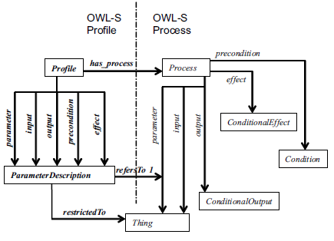
Profile to Process Bridge (2)
Chapter 6
A Semantic Web Primer

Slide 99
Profile to Process Bridge (3)
IOPEs play different roles for the Profile and for the Process
In the Profile ontology they are treated equally as parameters of the Profile
In the Process ontology only inputs and outputs are regarded as subproperties of the process:parameter property
Chapter 6
A Semantic Web Primer

Slide 100
Profile to Process Bridge (4)
The precondition and effects are just simple properties of the Process
IOPEs are properties both for Profile and Process
  The fact that they are treated differently at a conceptual level is misleading
The link between the IOPEs in the Profile and Process part of the OWL-S descriptions is created by the refersTo property which has
  As domain ParameterDescription
  Ranges over the process:parameter
Chapter 6
A Semantic Web Primer

Slide 101
The Grounding ontology
The grounding to a WSDL description is performed according to three rules:
  Each AtomicProcess corresponds to one WSDL operation
  Each input of an AtomicProcess is mapped to a corresponding messagepart in the input message of the WSDL operation. Similarly for outputs
  The type of each WSDL message part can bi specified in terms of a OWL-S parameter
Chapter 6
A Semantic Web Primer

Slide 102
The Grounding ontology Example
Service MedicareSupplier :
*Profile : …
*ProcessModel : …
*WSDLGrounding:
WsdlAtomicProcessGrounding : Gr1 (P1>op:GetSupplierByZipCode)
WsdlAtomicProcessGrounding : Gr2
(P1->op:GetSupplierByCity)
WsdlAtomicProcessGrounding : Gr3
(P1->op:GetSupplierBySupplyType)
Chapter 6
A Semantic Web Primer

Slide 103
Design Principles of OWL-S
Semantic versus Syntactic descriptions
  OWL-S distinguishes between the semantic and syntactic aspects of the described entity
  The Profile and Process ontologies allow for a semantic description of the Web service, and the WSDL description encodes its syntactic aspects
  The Grounding ontology provides a mapping between the semantic and the syntactic parts of a description facilitating flexible association between them
Chapter 6
A Semantic Web Primer

Slide 104
Design Principles of OWL-S (2)
Generic versus domain knowledge
  OWL-S offers a core set of primitives to specify the type of Web service
  These descriptions can be enriched with domain knowledge specified in a separate domain ontology
  This modeling choice allows using the core set of primitives across several domains
Chapter 6
A Semantic Web Primer

Slide 105
Design Principles of OWL-S (3)
Modularity
  Another feature of OWL-S is the partitioning of the description over several concepts
  There are several advantages of this modular modeling
    It is easy to reuse certain parts
    Service specification becomes flexible because if is possible to specify only the part that is relevant for the service
    Any OWL-S description is easy to extend by specializing the OWL-S concepts
Chapter 6
A Semantic Web Primer

Slide 106
Web Service Domain Ontology
Externally defined knowledge plays a major role in each OWL-S description
OWL-S offers a generic framework to describe a service, but to make it truly useful, domain knowledge is required
Chapter 6
A Semantic Web Primer

Slide 107
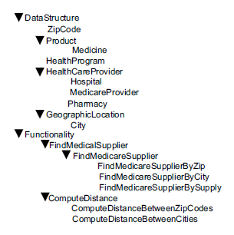
Web Service Domain Ontology (2)
Chapter 6
A Semantic Web Primer

Slide 108
Web Service Domain Ontology (3)
Previous figure specifies a DataStructure hierarchy and a Functionality ability
The Functionality hierarch contains a classification of service capabilities
Two generic classes of service capabilities are shown here
  One for finding a medical supplier
  One for calculating distances between two locations
Each of these generic categories has more specialized capabilities either by restricting the type of the output parameters or the input parameters
Chapter 6
A Semantic Web Primer

Slide 109
Web Service Domain Ontology (4)
The complexity of the reasoning tasks that can be performed with semantic Web service descriptions is conditioned by several factors
  All Web services in a domain should use concepts from the same domain ontology in their descriptions
  The richness of the available knowledge is crucial for performing complex reasoning
Chapter 6
A Semantic Web Primer

Slide 110
Web Service Domain Ontology Example Scenario
The right services for the task can be selected automatically from a collection of services
Semantic metadata allow a flexible selection that can retrieve services that partially match a request but are still potentially interesting
Chapter 6
A Semantic Web Primer

Slide 111
Web Service Domain Ontology Example Scenario (2)
A service that finds details of medical suppliers will be considered a match for a request for services that retrieve details of Medicare suppliers, if the Web service domain ontology specifies that a MedicareSupplier is a type of MedicalSupplier
This matchmaking is superior to the keyword-based search offered by UDDI
Chapter 6
A Semantic Web Primer

Slide 112
Web Service Domain Ontology Example Scenario (3)
The composition of several services into a more complex service can also be automated
After being discovered and composed based on their semantic descriptions, the services can be invoked to solve the task at hand
Chapter 6
A Semantic Web Primer

Slide 113
Lecture Outline
Horizontal Information Products at Elsevier
Openacademia: Distributed Publication Management
Bibster: Data Exchange in a P2P System
Data Integration at Audi
Skill Finding at Swiss Life
Think Tank Portal at EnerSearch
E-Learning
Web Services
Other Scenarios
Chapter 6
A Semantic Web Primer

Slide 114
Multimedia Collection Indexing at Scotland Yard
Theft of art and antique objects
International databases of stolen art objects exist
  It is difficult to locate specific objects in these databases
  Different parties are likely to offer different descriptions
  Human experts are needed to match objects to database entries
Chapter 6
A Semantic Web Primer

Slide 115
Multimedia Collection Indexing at Scotland Yard – The Solution
Develop controlled vocabularies such as the Art and Architecture Thesaurus (AAT) from the Getty Trust, or Iconclass thesaurus
Extend them into full-blown ontologies
Develop automatic classifiers using ontological background knowledge
Deal with the ontology-mapping problem
Chapter 6
A Semantic Web Primer

Slide 116
Online Procurement at
Daimler-Chrysler – The Problem
Static, long-term agreements with a fixed set of suppliers can be replaced by dynamic, short-term agreements in a competitive open marketplace
Whenever a supplier is offering a better deal, Daimler-Chrysler wants to be able to switch
Major drivers behind B2B e-commerce
Chapter 6
A Semantic Web Primer

Slide 117
Online Procurement at
Daimler-Chrysler – The Solution
Rosetta Net is an organization dedicated to such standardization efforts
XML-based, no semantics
Use RDF Schema and OWL instead
  Product descriptions would “carry their semantics on their sleeve”
  Much more liberal online B2B procurement processes would exist than currently possible
Chapter 6
A Semantic Web Primer

Slide 118
Device Interoperability at Nokia
Explosive proliferation of digital devices:
  PDAs, mobiles, digital cameras, laptops, wireless access in public places, GPS-enabled cars
Interoperability among these devices?
The pervasiveness and the wireless nature of these devices require network architectures to support automatic, ad hoc configuration
A key technology of true ad hoc networks is service discovery
Chapter 6
A Semantic Web Primer

Slide 119
Device Interoperability at Nokia (2)
Current service discovery and capability description require a priori identification of what to communicate or discuss
A more attractive approach would be “serendipitous interoperability”
  Interoperability under “unchoreographed” conditions
  Devices necessarily designed to work together
Chapter 6
A Semantic Web Primer

Slide 120
Device Interoperability at Nokia (3)
These devices should be able to:
  Discover each others’ functionality
  Take advantage of it
Devices must be able to “understand” other devices and reason about their functionality
Ontologies are required to make such “unchoreographed” understanding of functionalities possible
Chapter 6
A Semantic Web Primer

